Slide 1
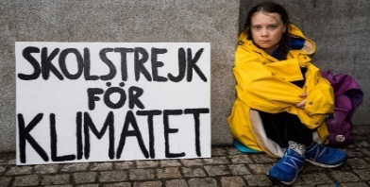
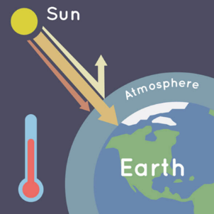
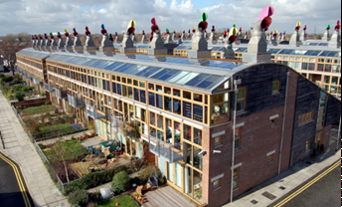
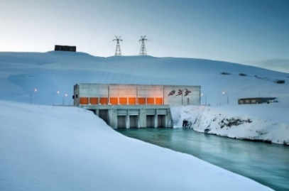
Vocabulary
biome | a large area characterised by its vegetation, soil, climate and wildlife
environment | the natural world as a whole or in a particular geographical area
climate change | the shift in the earth's usual weather conditions over many years
atmosphere | the layer of gases surrounding the earth
greenhouse gases | carbon dioxide, methane, water vapour
global warming | When greenhouse gasses are released into the atmosphere, more heat is trapped, making the planet warmer.
carbon footprint | the amount of carbon dioxide released into the air because of your own energy needs
carbon emissions | the release of carbon into the atmosphere
fossil fuels | a natural fuel such as coal or gas, formed from the remains of living things
thematic map | a type of map that portrays the geographic pattern of a particular subject matter
Locational Knowledge
Top 7 countries most affected by climate change: Japan Philippines Germany Madagascar India Sri Lanka Kenya
Geography – Year 6
Spring
Knowledge of environmental, physical and human geography processes
Five major biomes: Aquatic Grassland Forest Desert Tundra | Climate zones: Mediterranean Arid Tropical Mountain Polar Temperate
Human Geography – Human causes of climate change
Oil and gas | Industrialization | Oil drilling | Transport and vehicles | Over fishing
Consumerism | Deforestation | Over farming | Power plants | Waste
Australian Bushfires 2019 - 2020
A result of global warming 250 billion tonnes of CO2 released Homes destroyed Animals died / lost habitats
Japan
Rising temperatures are hindering production of vital grain (rice), fish and fruit Frequent tsunamis, and storms Coral reefs are dying
Iceland
Aims to be carbon neutral by 2040 All of the city’s electricity is produced with hydroelectric power Houses are geothermally heated
BEDZED
UK’s first major zero carbon community Eco-village in South London 100 homes with major electricity and energy savings
Physical Geography – Impacts of climate change
Rise in sea levels Ice caps are melting Animal extinction – habitats destroyed Extreme weather and frequent storms – flooding, tsunamis, bushfires Hotter temperatures (bushfires, droughts)
Geographical Skills and Fieldwork
Geographers can use thematic maps to show a theme connected with a specific geographic area. Geographers can make clearly explained links between observations or changes locally and the wider world.

Slide 2
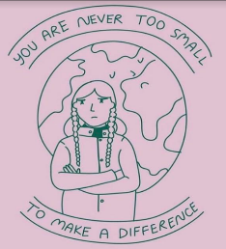
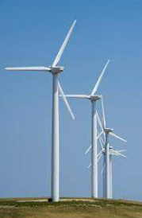
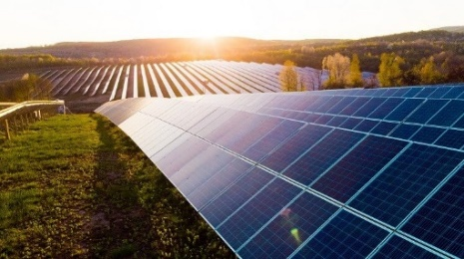
Vocabulary
 | a zone that is categorised by a generally consistent climate
 | a large area characterised by its vegetation, soil, climate and wildlife
 | the natural world as a whole or in a particular geographical area
 | the shift in the Earth's usual weather conditions over many years
 | the layer of gases surrounding the earth
 | carbon dioxide, methane, water vapour
 | When greenhouse gasses are released into the atmosphere, more heat is trapped, making the planet warmer.
 | the amount of carbon dioxide released into the air because of your own energy needs
 | the release of carbon into the atmosphere
 | a natural fuel such as coal or gas, formed from the remains of living things
 | a type of map that portrays the geographic pattern of a particular subject matter
 | an area with distinct plant types, determined by climate, soil, drainage and elevation
Locational Knowledge
Top 7 countries most affected by climate change:
Geography – Year 6
Spring
Knowledge of environmental, physical and human geography processes
Five major biomes: _________ _________ _________ _________ _________ | Six climate zones: _________ _________ _________ _________ _________ _________
Human Geography
Human causes of climate change
Australian Bushfires 20__ __ - 20_0
Japan
BEDZED
UK’s first major ______ _________ community Eco-village in _______ __________ ______ homes with major electricity and energy savings
Iceland
Physical Geography
Physical impacts of climate change
Geographical Skills and Fieldwork
Geographers can use thematic maps to show a theme connected with a specific geographic area. Geographers can make clearly explained links between observations or changes locally and the wider world.

