Slide 1
Set 1 Sounds
Read Write Inc

Slide 2
Down Maisie, mountain, mountain.

Slide 3
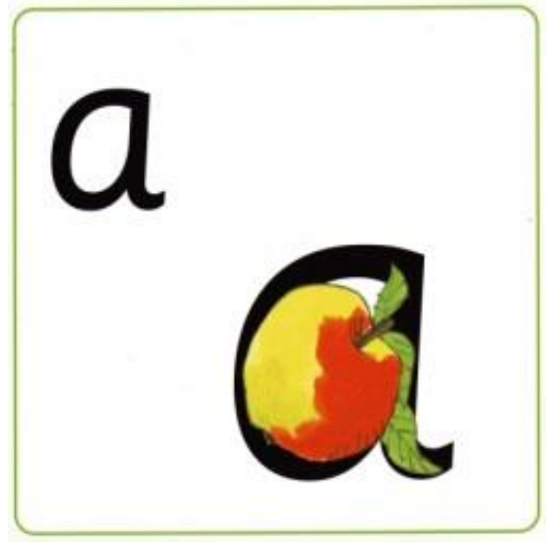
Around the apple and down the leaf.

Slide 4
Slither down the snake.

Slide 5
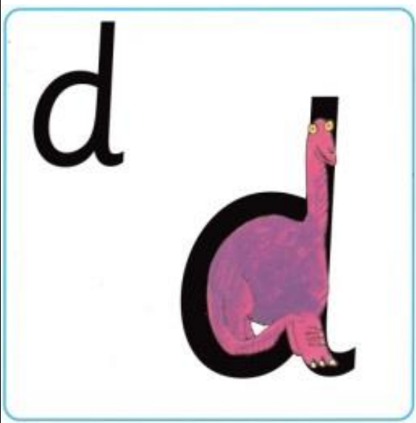
Around the dinosaurs bottom, up his tall neck and down to his toes.

Slide 6
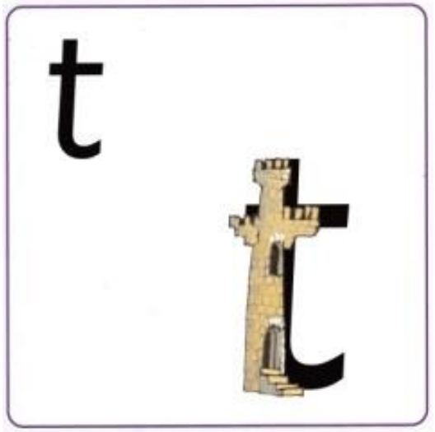
Down the tower, across the tower.

Slide 7
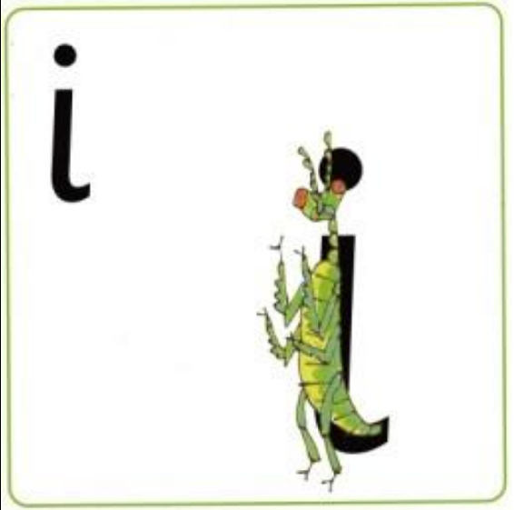
Down the body and dot for the head.

Slide 8
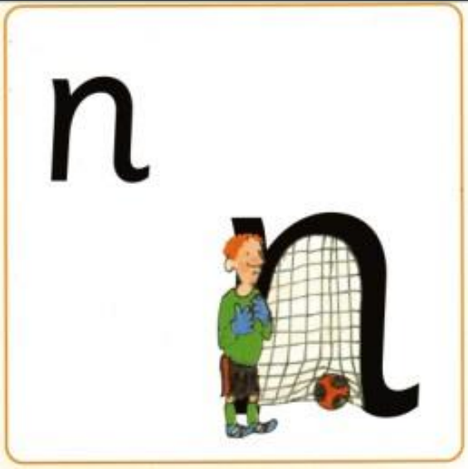
Down Nobby and over his net.

Slide 9
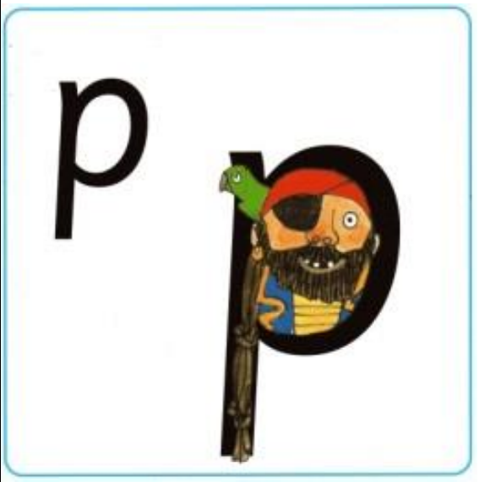
Down the pirates plait and around his face.

Slide 10
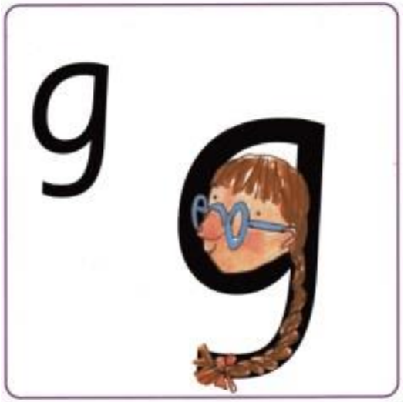
Around the girls face, down her hair and give her a curl.

Slide 11
All around the orange.

Slide 12
Curl around the caterpillar.

Slide 13
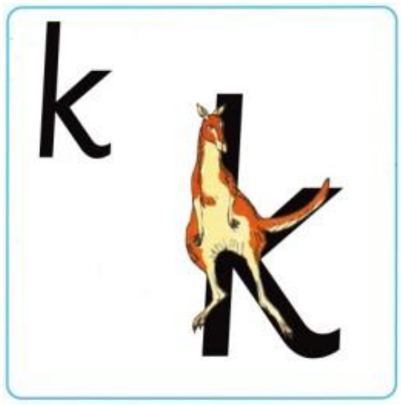
Down the kangaroo’s body tail and leg.

Slide 14
Down and under, up to the top and draw the puddle.

Slide 15
Down the laces to the heel and around the toe.

Slide 16
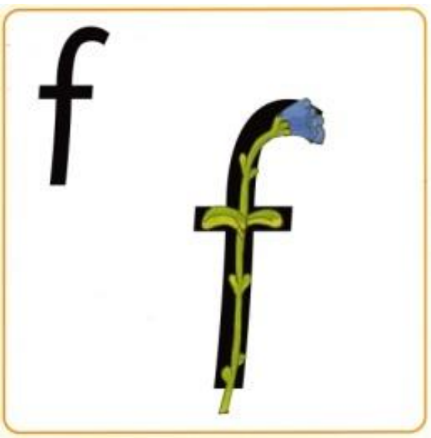
Down the stem and draw the leaves.

Slide 17
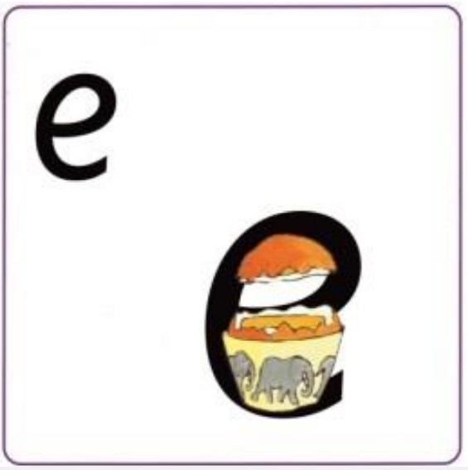
Lift off the top and scoop out the egg.

Slide 18
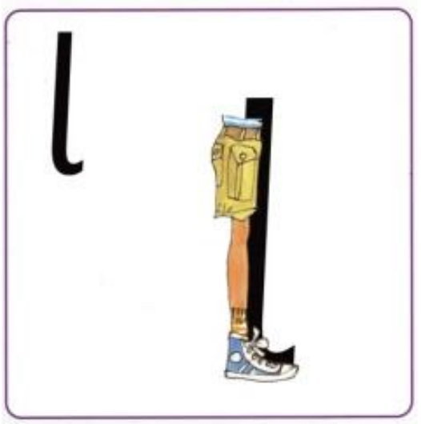
Down the long leg.

Slide 19
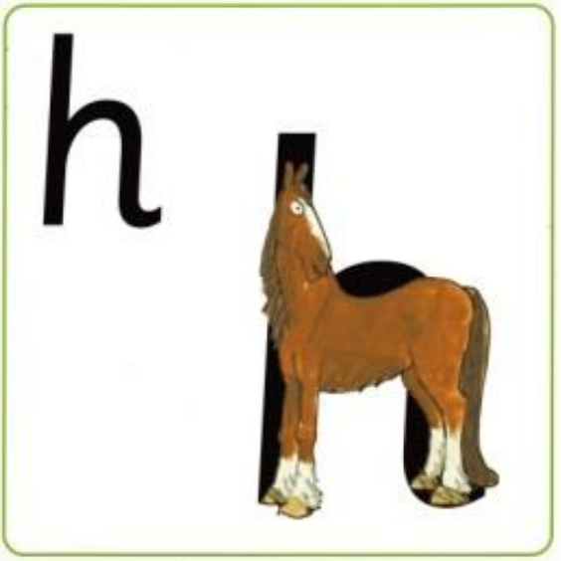
Down the head, to his hooves and over his back.

Slide 20
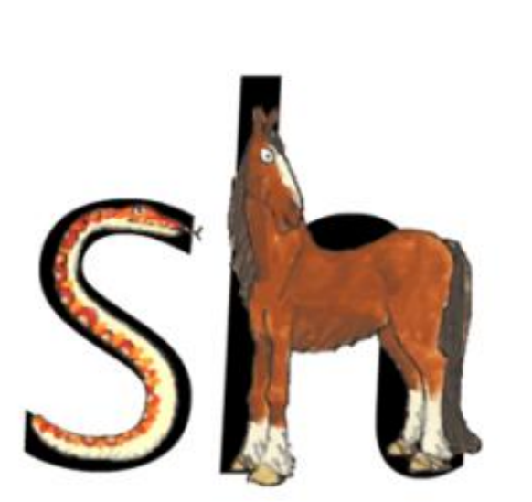
The horse says “shush” to the hissing snake!

Slide 21
Down the robots back and curl over his arm.

Slide 22
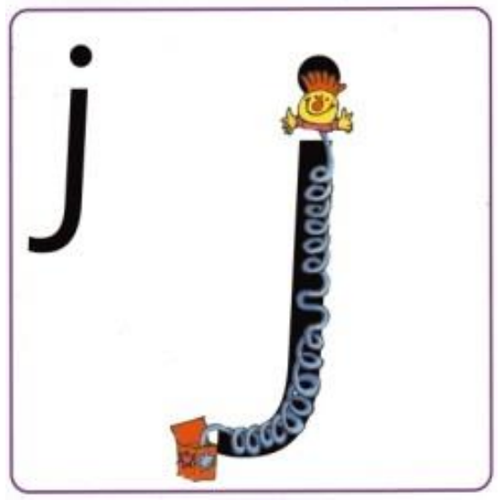
Down his body, curl, dot for his head.

Slide 23
Down a wing, up a wing.

Slide 24
Down a horn, up a horn and under head.

Slide 25
Down, up, down, up.

Slide 26
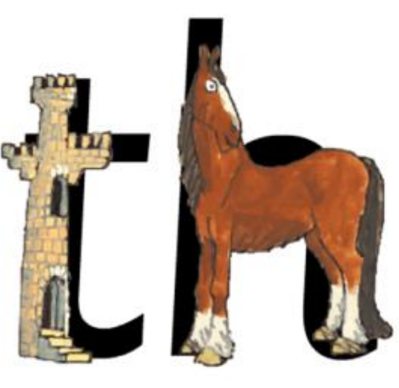
The princess in the tower is recued by the horse.

Slide 27
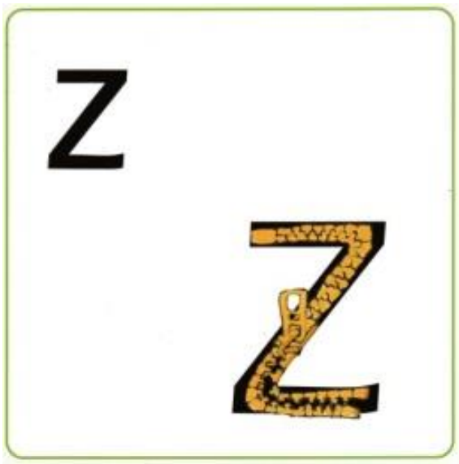
Zig-zag-zig.

Slide 28
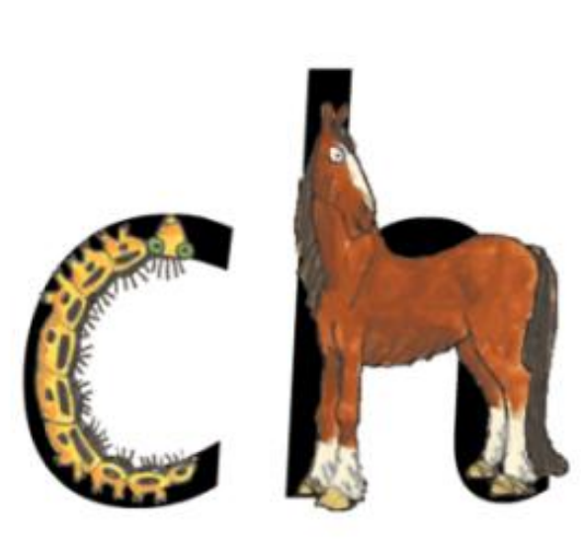
The horse sneezes when the caterpillar’s hairs get up his nose! ch – ch – ch – choo!

Slide 29
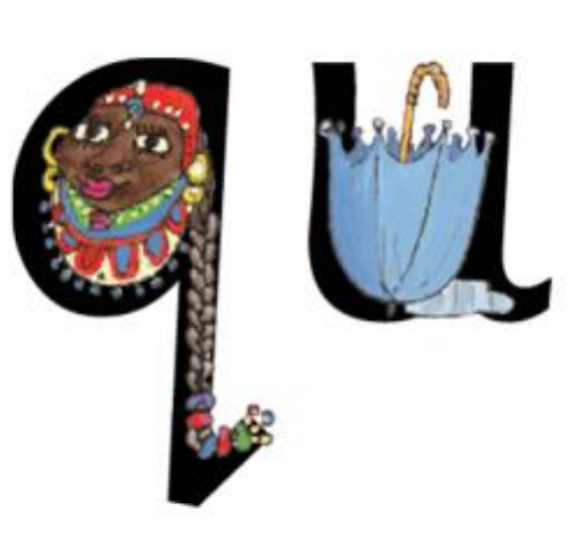
Round her head, up past her earrings and down her hair.
The Queen never goes outside without her umbrella!

Slide 30
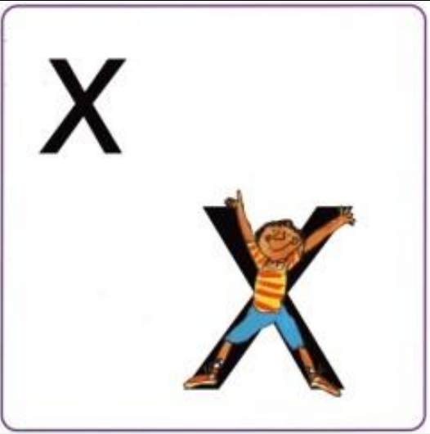
Down the arm and leg, repeat the other side.

Slide 31
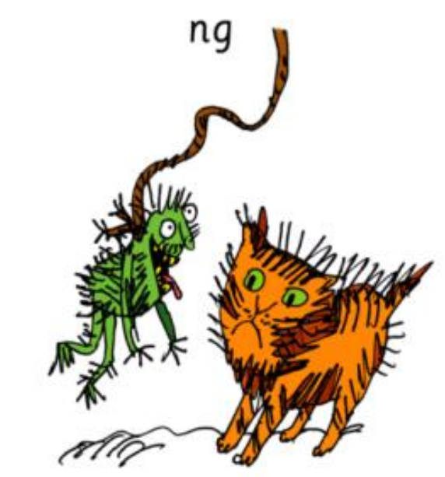
A thing on a string!

Slide 32
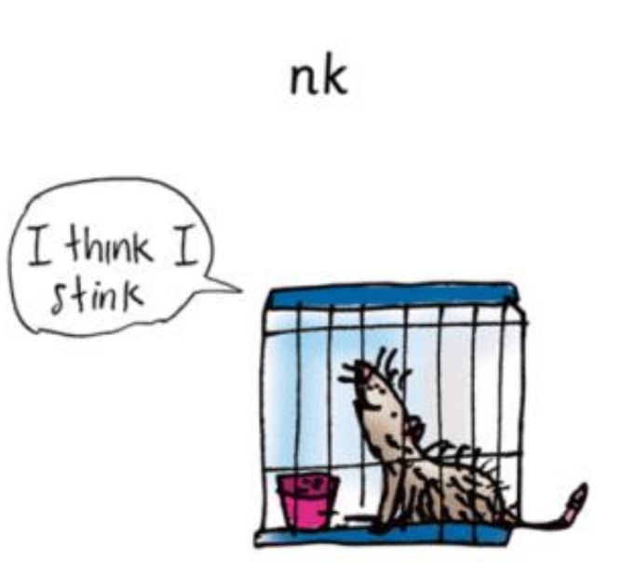
I think I stink!

