Slide 1
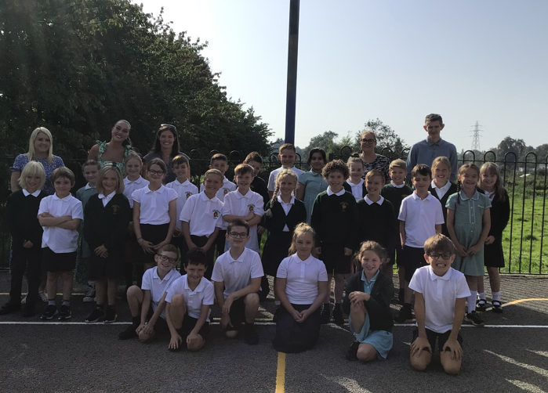
Welcome to Beech Class

Slide 2
Teachers Class Teacher - Miss Lunny Teaching Assistants: Mrs Crockard, Miss Lawson, Mr Kelly, Miss Knowles PE: Mr Grooms

Slide 3
A little bit about us
Miss Lunny has been teaching for 10 years. Predominantly in Years 4,5 and 6
All of the teaching assistants worked with the children last year so know the children very well!

Slide 4
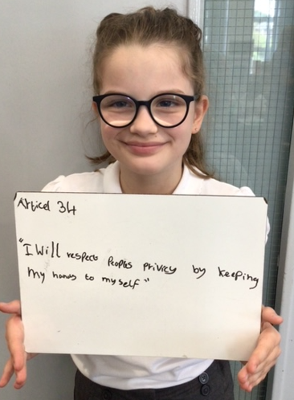
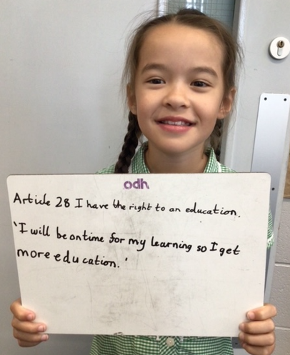
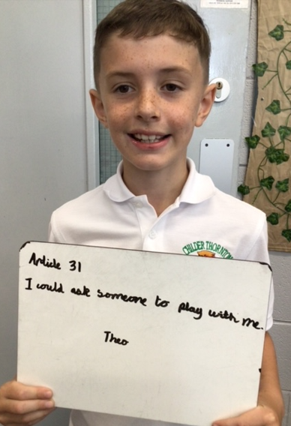
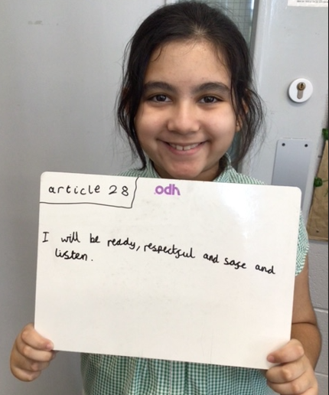
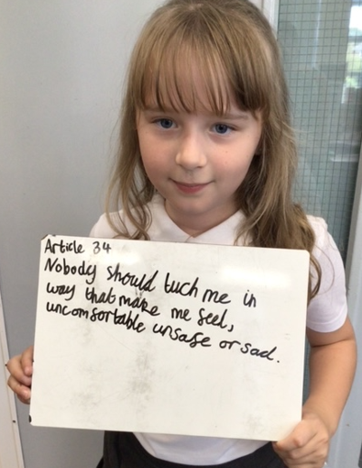
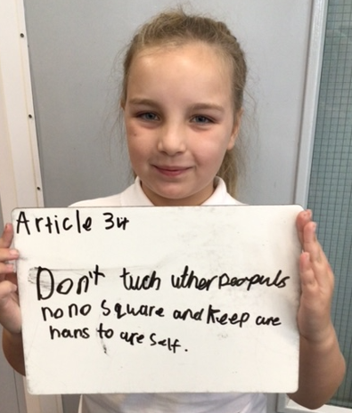
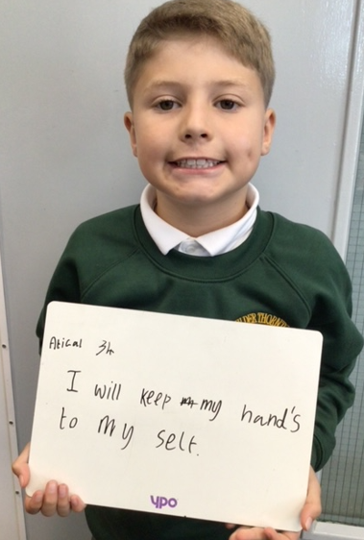
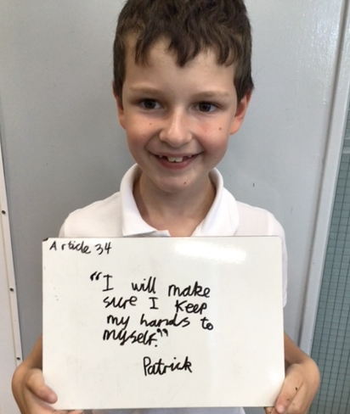
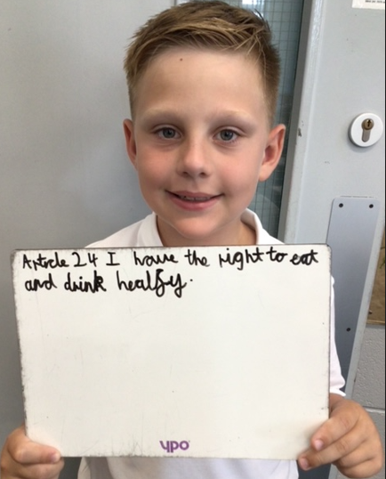
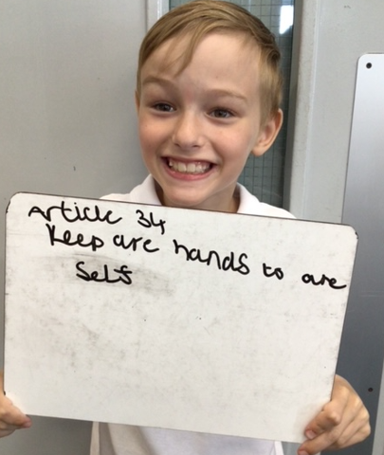
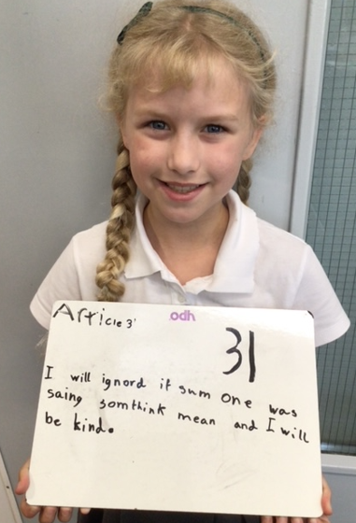
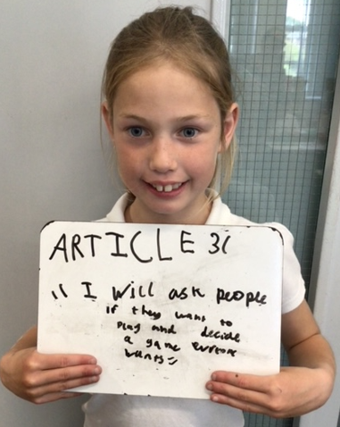
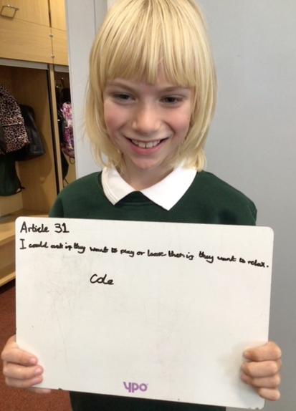
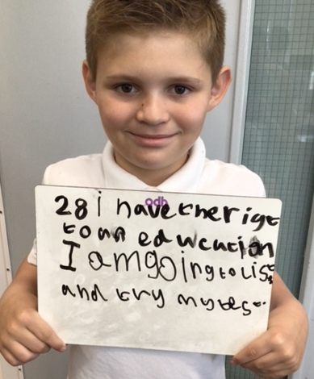
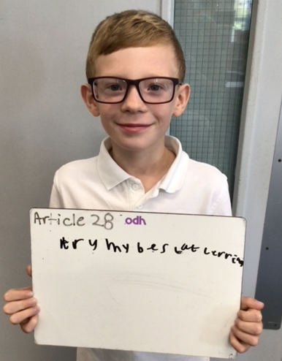
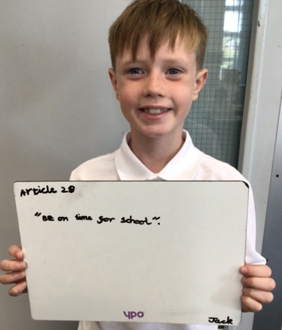
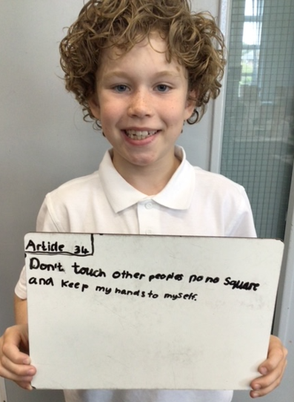
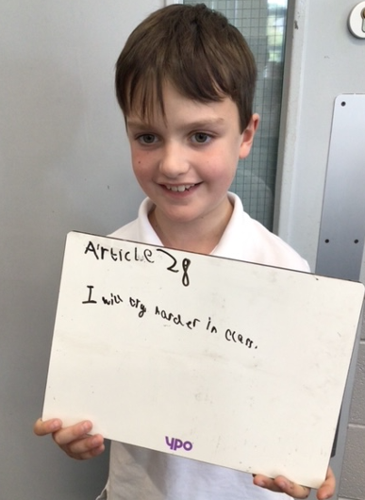
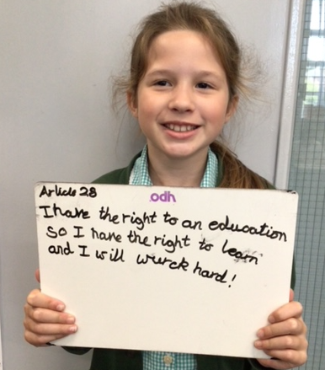
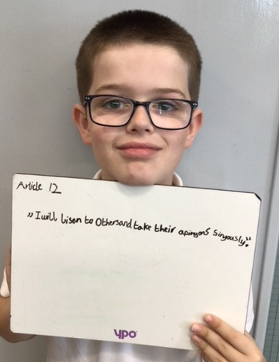
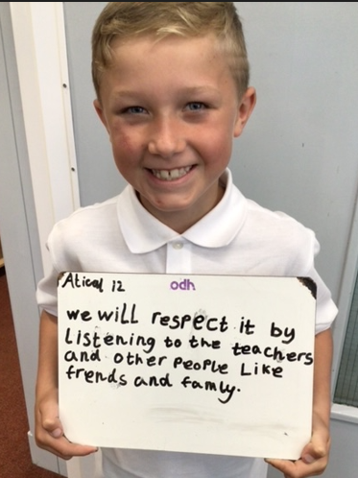
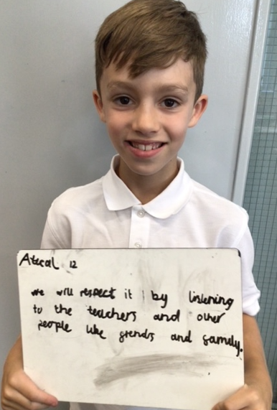
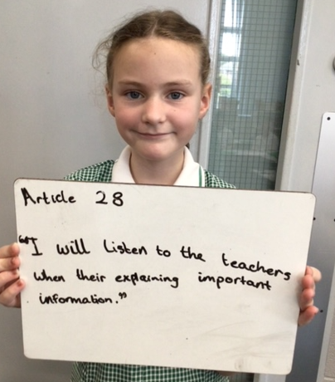
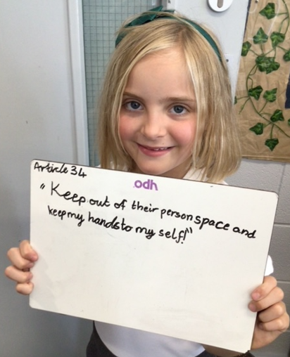
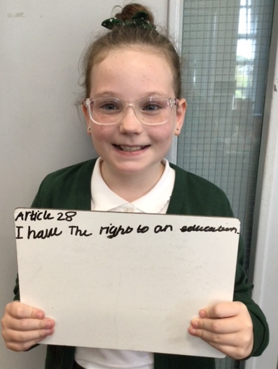
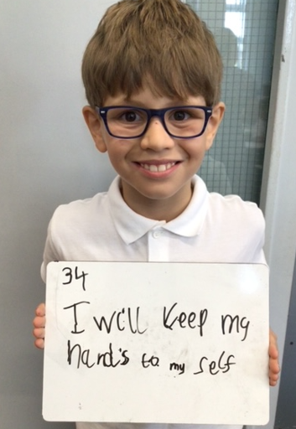
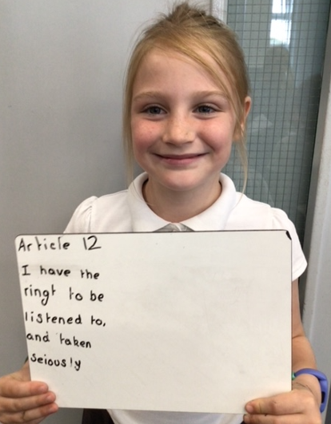
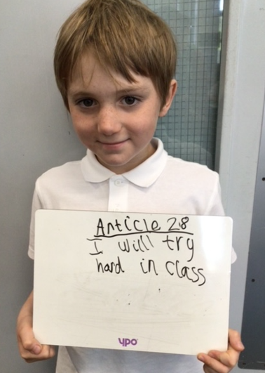
Our Values
Curriculum
‘Our Wonderful World’
Curiosity, creativity, broadmindedness, responsibility, enjoying life, sense of belonging
Behaviour
Ready, Respectful, Safe
Ethos
No Outsiders

Slide 5
Key dates
Monday 18th September – After school clubs start
Parents’ Evening (Wednesday 1st and Thursday 2nd November)
Residential – 15th – 17th May 2023
Year 4 Multiplication check –June

Slide 6
Timetable
 | Monday | Tuesday | Wednesday | Thursday | Friday
AM | 4 a day reading maths English Handwriting class novel | 4 a day reading maths English handwriting class novel | 4 a day reading maths English handwriting class novel | 4 a day reading maths English handwriting class novel | 4 a day reading maths English handwriting class novel
PM | spelling (RWI) | spelling (RWI) | spelling (RWI) | PE | spelling (RWI)
 | science | History/geography | Spanish – every other week RE/Heartsmart |  | Art/DT/computing/music Assembly
PE - kits to be brought in at the beginning of the week and taken home at the end.
Swimming – Term 2

Slide 7
Curriculum

Slide 8
Maths
Autumn | Spring | Summer
Place Value Addition and subtraction Measure - area Multiplication and division | Multiplication and division Length and perimeter Fractions Decimals | Decimals Money Time Geometry – angle and 3D shapes Statistics Geometry – Position and direction
Discover, share, think, challenge, workbook!

Slide 9
TT Rockstars
Little and often
Repetitive to enable automaticity - may seem easy but children need to be under 2 secs per question to move on
Gigs will assess as the children progress
Games - Garage
Studio- 12x12, sets the speed
Soundcheck- Year 4 multiplication check
Arena- Similar to garage but against others
Festival- 12x12, against others
Rockslam- Challenge others 12x12

Slide 10
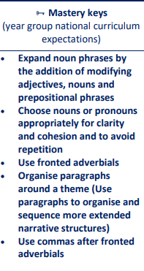
English - writing
Autumn | Spring | Summer
Autumn 1 Gorilla – Anthony Browne Autumn 2 Zeraffa Giraffa by Dianne Hofmeyr | Spring 1 Leon and the place between by Graham Baker-Smith Spring 2 When the Giant stirred by Celia Godkin | Summer 1 Where the Forest Meets the Sea by Jeannie Baker Summer 2 Cloud Tea Monkeys by Mal Peet

Slide 11
English - reading
Class page – website
It is important that your child is reading frequently to support their writing – building vocabulary, recognising spelling patterns.
Reading regularly will improve their reading speed and fluency.
Class library and books from home.
Children need to be interested and have the right attitude!
T will check recorded in their reading records. Both children and adults can write in diaries.

Slide 12
Shared reading
Shared reading daily in Year 4
Class novel each half term (The Wild Robot) – Retrieval focus
Alternative texts – linked to learning
Quick quiz, partner talk, independent tasks, solo work

Slide 13
English - reading
Reading with your child and questions you might want to ask.
Retrieval – literally pulling it from the text
Who went to fetch the eggs from the shop?
Why did Tom move his tractor?
Prediction
What may happen next?
Who is going to do something?
Inference – inferring something using evidence in the text to prove this
Point evidence, point evidence
What impression did you get of Billy? (Point and why)
Why might Bob think Bill is …..?
Summarise
Summarise what you have read on pg14.

Slide 14
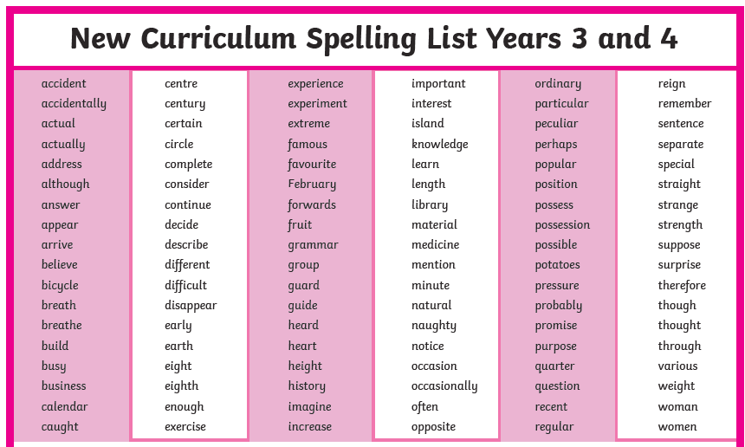
English - Spelling
Spellings (RWI):
New spellings in log books every week.
School and home.
Your child will record spelling they have found tricky in this book to share with you at home.
This will reinforce the learning of new words.
Spellings Year 3 and 4 words

Slide 15
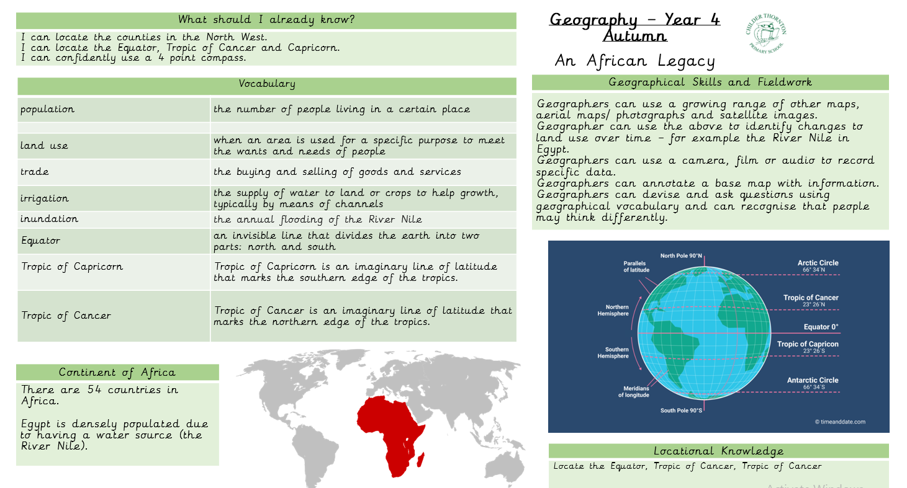
History and Geography
Knowledge Organisers
Using the vocabulary confidently
Recognising key dates and plotting on a timeline
Recalling facts on important historical moments
Term 1 – An African legacy

Slide 16
Topic – An African Legacy
Where is Africa?
Locating certain countries in Africa and recognising physical features which affect population density
Ancient Egypt – links to River Nile
Mummification
Building of the Pyramids
Nelson Mandela - Apartheid
Planning a trip to Liverpool World Museum
Term 2 – Explorers ‘Trading where others haven’t’ Term 3 – Fair Trade - Fair enough?

Slide 17
Science
Autumn | Spring | Summer
Living things and their habitats | Animals including Humans (digestion and teeth) States of matter | Electricity – circuits Sound

Slide 18
Homework
Reading – ‘strive for 5’
TTRS
10 minutes on Garage (personal to the child)
5 minutes on Studio (speed for a range of multiplication facts)
Spellings – Log book
Thanks so much in advance for your support!!

Slide 19
Times Tables Test
Nothing to worry or stress about!!
Statutory government test for all Year 4 children
Purpose – To determine whether children can fluently recall times tables up to 12 x 12
25 questions with 6 seconds to answer each. 3 second gap in between.
Around 5 minutes
Test is on an ipad
How can I support? – Make it fun!
TT Rock Stars (Soundcheck)
Hit the Button game

Slide 20
Home school communication
Email
Phone calls
Seesaw
Newsletter
Twitter
Parents’ Evening – November
School website – Beech class page

Slide 21
Thank you for attending this ‘Meet the teacher’ Any questions?

